Slide 1
KAnnotator: Inferring Type Information from Java Byte Codes
Alexey Sedunov
Andrey Breslav
Svetlana Isakova
Evgeny Gerashchenko
JetBrains, s. r. o.
2013

Slide 2
Annotation Inference
Several languages on the Java platform refine Java type system to ensure program safety at compile-time
Kotlin: nullable/non-nullable types
In practice interoperability with existing Java code requires developers to provide missing type information, e.g. in a form of annotations.
KAnnotator is a tool which automatically infers type annotations for a given set of classes (libraries) based on their bytecode

Slide 3
KAnnotator Features
Annotation inference based on the bytecode of library classes
@Nullable/@NotNull
@Mutable
Support of predefined annotations
Internal vs. external annotations
Verification mode
Extensible context-insensitive inference engine
Open-source
https://github.com/jetbrains/kannotator

Slide 4
Comparison
Julia
http://julia.scienze.univr.it/
general framework
more precise
longer runtime
JQual
http://www.cs.umd.edu/projects/PL/jqual/
general framework
more precise mutability
AST-driven
NIT
http://nit.gforge.inria.fr/
sound theory
more precise treatment of fields
specialized
longer runtime

Slide 5
Inference Process Overview
Load predefined annotations
Load class files
Construct dependency & inheritance graphs
Apply inference to dependency graph
Propagate annotations
Process conflicts

Slide 6
Bytecode Inference Engine
Inference engine is based on the ObjectWeb 2 ASM data-flow analysis framework
Compatible with ASM bytecode representation
Does not require explicit construction of CFG
Analyzer iterates over execution paths until all frames are stabilized
Improvements to the ASM analyzer:
Pseudo-errors corresponding to possible abnormal terminations
Detection of unreachable paths
Analysis-specific frame transformers

Slide 7
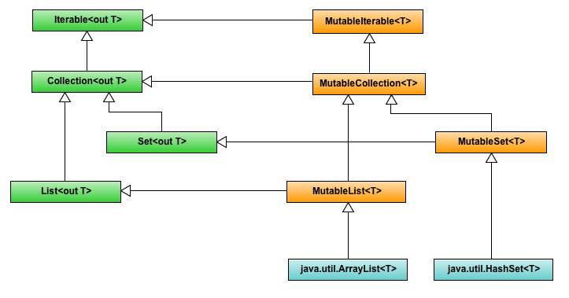
Mutability: Motivation

Slide 8
Mutability: Mutating Invocations
<T> void copy(
@ReadOnly Collection<T> from,
@Mutable Collection<T> to
) {
for (T fromElement : from) {
//mutating invocation
to.add(fromElement);
}
}

Slide 9
Mutability: Propagating Invocations
<T> void removeFirst(
@Mutable Iterable<T> a
) {
//mutability propagating invocation
Iterator<T> it = a.iterator();
if (it.hasNext()) {
it.remove();
}
}

Slide 10
Nullability: Motivation
<T> List<T> sort(Collection<T> a) {
List<T> list = new ArrayList<T>(a);
Collections.sort(list);
return list;
}
JAVA
fun sort(
a: Collection<T?>?
):List<T?>?
fun sort(
a: Collection<T?>
):List<T?>
KOTLIN
No type information

Slide 11
Nullability: Annotation Criteria
Null does not reach ANY error node
Null does not reach ANY return node
@Nullable
UNKNOWN
No Null is lost
@NotNull
Null or Not Null reach SOME return node
Null reaches SOME error node

Slide 12
Nullability: @Nullable
void foo1(@Nullable String s) {
if (s == null) return;
bar(s);
// null reaches return
}
void foo2(@Nullable String s) {
if (s == null) s = "empty";
bar(s);
// not-null reaches return
}

Slide 13
Nullability: @NotNull
void foo3(@NotNull String s) {
if (s == null) {
throw new RuntimeException();
}
bar(s);
}
void foo4(@NotNull String s) {
if (s.isEmpty()) return;
bar(s);
}

Slide 14
Nullability: Unknown
void foo5(String s) {
if (check(s)) {
throw new RuntimeException();
}
if (s == null) {
s = "empty";
}
bar(s);
}

Slide 15
Statistics
 | Size (MB) | Number of methods | Time (Preprocess /Analyze) | @NotNull /@Mutable (%)
OW2 ASM 4.0 | 0.3 | 1660 | <1s/~40s | 70.3/0.2
Guava 13.0 | 1.8 | 11101 | ~3s/~11s | 50.5/0.3
Java3D Core 1.3.1 | 2.4 | 6662 | ~2s/~70s | 86.7/0.0
Soot 2.5.0 | 6.0 | 33262 | ~6s/~4min | 94.2/0.6
JRE 1.7.12 (rt.jar) public packages only | 15.5 | 64012 | ~15s/~3min | 74.2/0.25
JRE 1.7.12 (rt.jar) full, restricted to public dependencies | 49.1 | 125229 | ~22s/~11min | 79.7/0.3
JRE 1.7.12 (rt.jar) full | 49.1 | 164179 | ~23s/ ~35min | 85.6/0.5

Slide 16
Summary
KAnnotator provides general framework for data-flow analysis
It supports nullability and collection mutability analysis
We used KAnnotator to generate annotations for some java libraries and several versions of the JRE standard library
We also built the IntelliJ Idea plugin which automatically annotates jar files of the project libraries
Future Work:
Extend data-flow framework to support context-sensitive analysis
Implement context-sensitive nullability analysis for generics
Increase precision of field nullability analysis
Implement more general mutability analysis

Slide 17
The End
JetBrains, s. r. o.
2013

